Slide 1

Innovative Laundry & Dry-Cleaning Software
Revolutionizing operations for efficiency and customer satisfaction

Slide 2






4
Item Reservation
Optimize your inventory and resource allocation by placing items with the same order number
1
Hybrid Connection
Simultaneous offline and online functionality. Ensuring that you stay connected and efficient, regardless of your internet status.
2
5
Image Capture
Mark stains or issues before cleaning. Customers can also view these photos on their phones
Comprehensive Ordering
Place an order with fewer clicks but more details.
3
Laundry Device Sync
Connect your dry-cleaning devices directly to our software via an open API
6
Innovative Real-Time Tracking
This system not only tracks items, but it also monitors employee working hours

Slide 3
1
Hybrid Connection
Simultaneous offline and online functionality. Ensuring that you stay connected and efficient, regardless of your internet status.
4
Item Reservation
Optimize your inventory and resource allocation by placing items with the same order number
2
5
Image Capture
Mark stains or issues before cleaning. Customers can also view these photos on their phones
Comprehensive Ordering
Place an order with fewer clicks but more details.
6
3
Innovative Real-Time Tracking
This system not only tracks items, but it also monitors employee working hours
Laundry Device Sync
Connect your dry-cleaning devices directly to our software via an open API

Slide 4
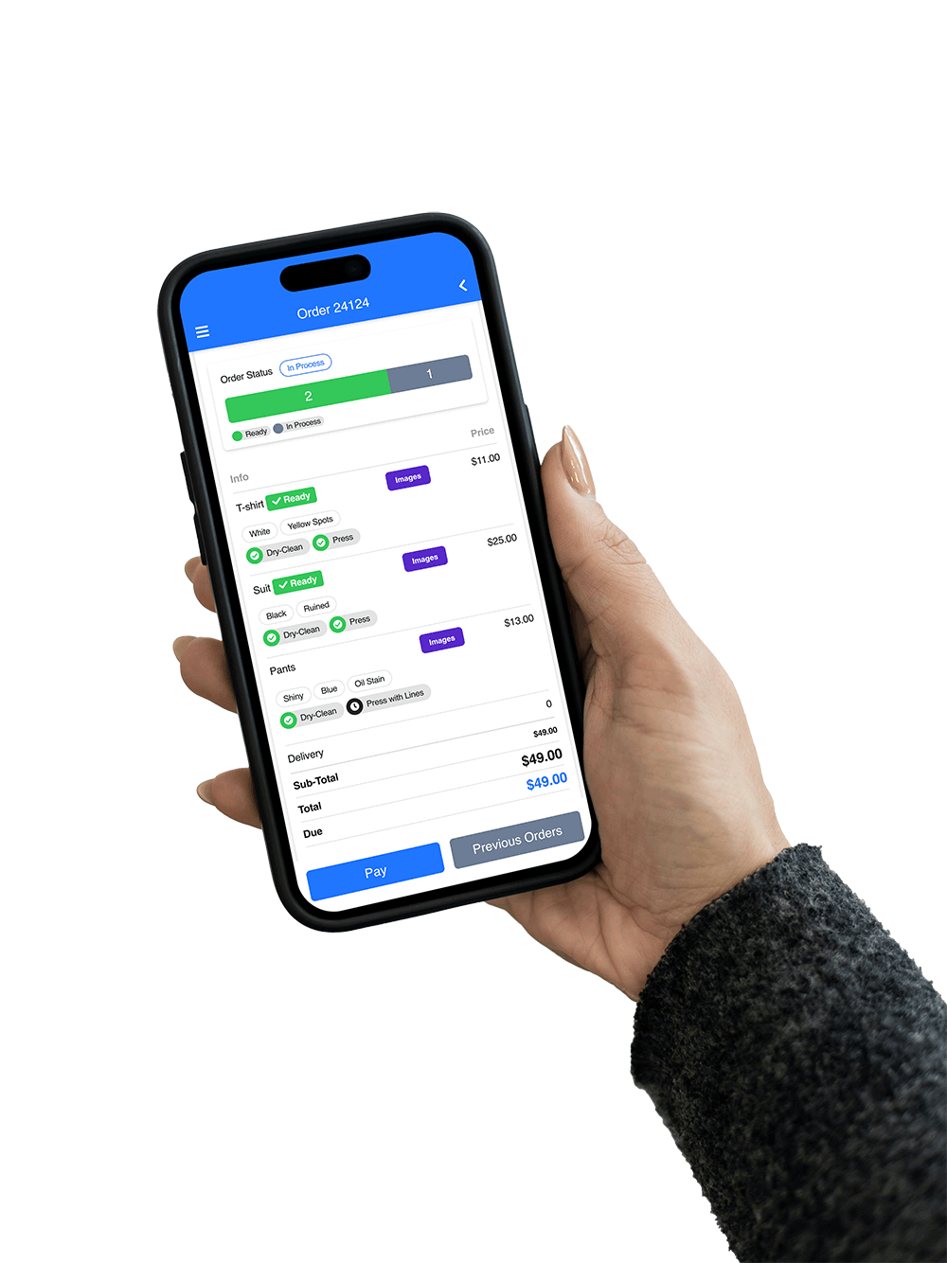
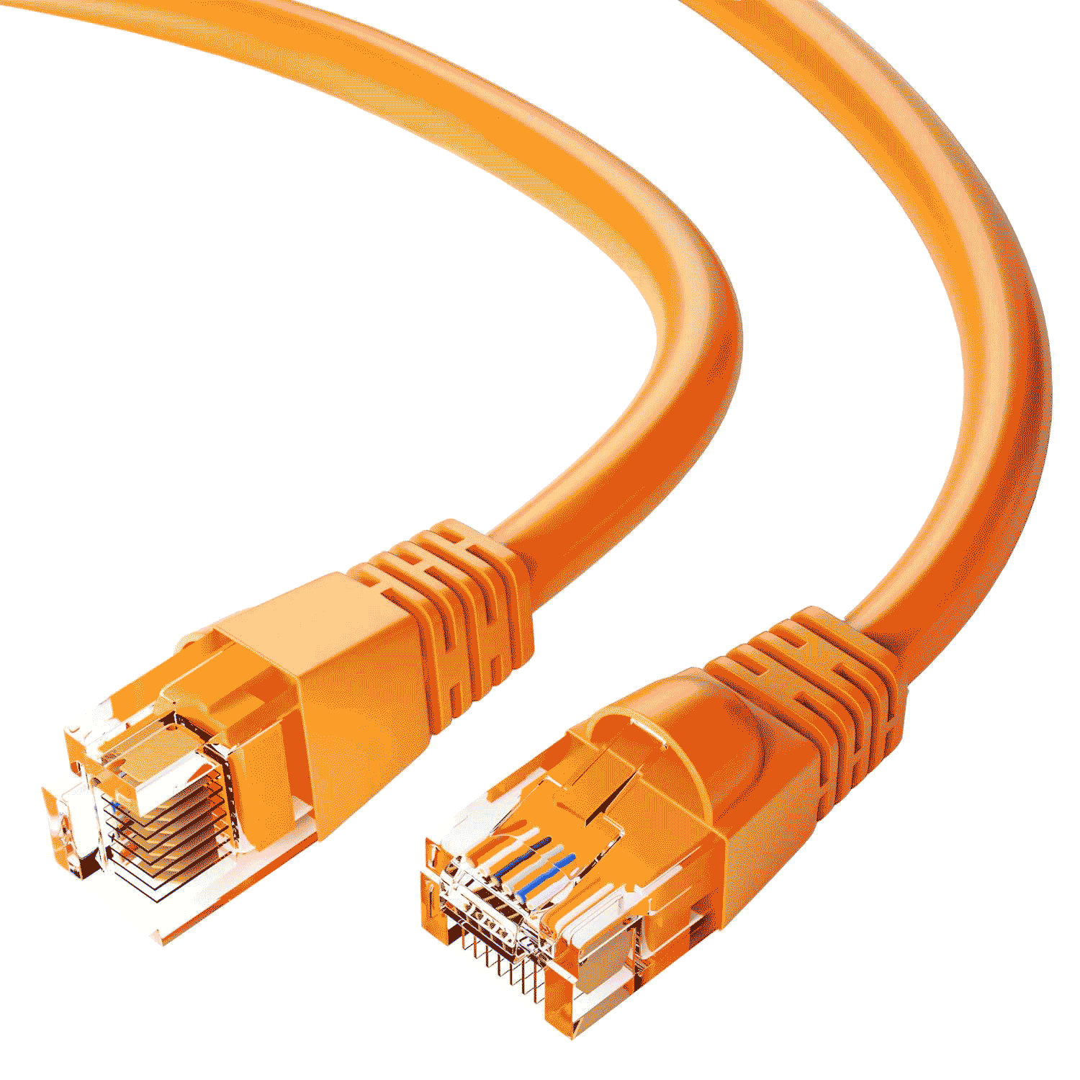
1
Hybrid Connection
Simultaneous offline and online functionality. Ensuring that you stay connected and efficient, regardless of your internet status.
4
Item Reservation
Optimize your inventory and resource allocation by placing items with the same order number
Benefits of Offline Setup:
2
Uninterrupted Workflow: Continue operations without worrying about internet outages.
5
Comprehensive Ordering
Place an order with fewer clicks but more details.
Image Capture
Mark stains or issues before cleaning. Customers can also view these photos on their phones
Secure Data Storage: All data is safely stored locally and syncs automatically once connected
Faster Access: Quick access to essential features without internet lag.
3
Integrated Online Features:
Laundry Device Sync
Connect your dry-cleaning devices directly to our software via an open API
6
Innovative Real-Time Tracking
This system not only tracks items, but it also monitors employee working hours
CRM Real-Time Updates: Online sections, such as CRM, sync securely with the main system. customer data and interactions are always updated.
Remote Access: Manage your business from anywhere with internet connectivity.

Slide 5


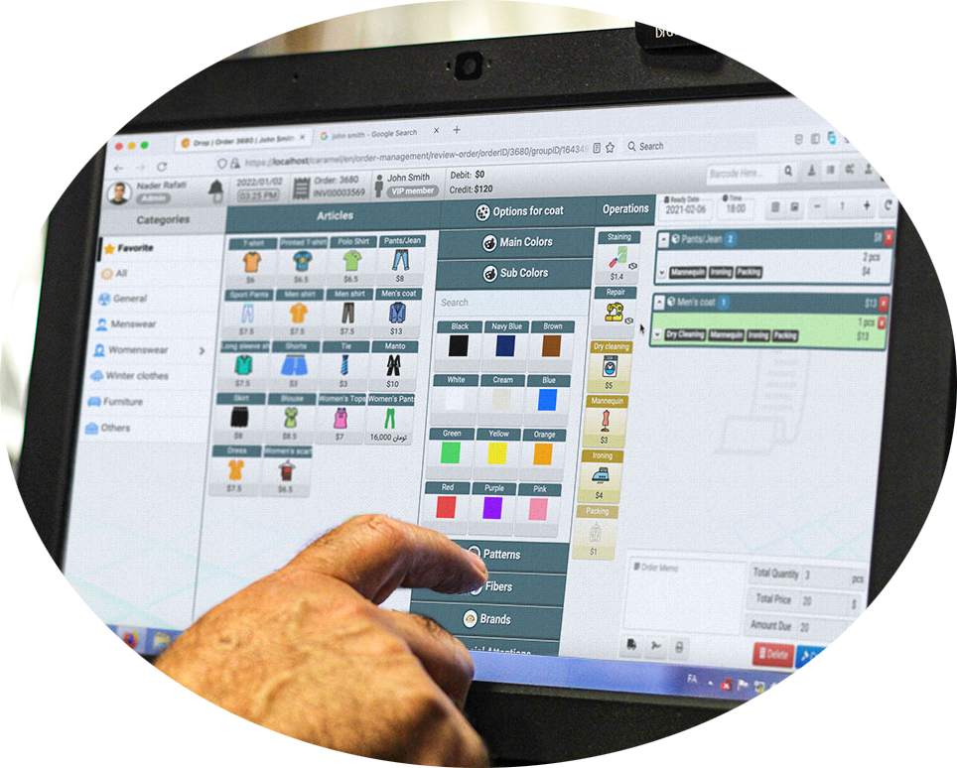

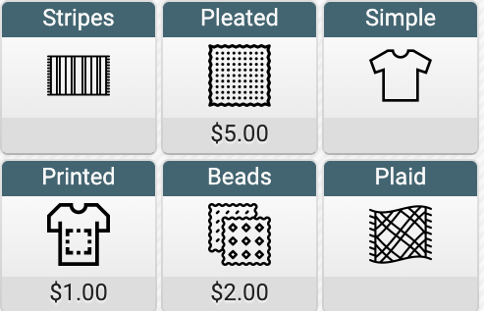
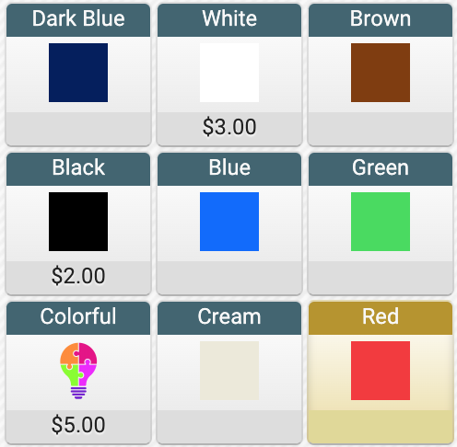
1
Hybrid Connection
Simultaneous offline and online functionality. Ensuring that you stay connected and efficient, regardless of your internet status.
2
Comprehensive Ordering
Place an order with fewer clicks but more details.
4
Item Reservation
Optimize your inventory and resource allocation by placing items with the same order number
One Page Design:
Faster ordering with a streamlined, single-page interface.
Dynamic Pricing:
Flexible item pricing based on selected options and operational requirements.
5
Image Capture
Mark stains or issues before cleaning. Customers can also view these photos on their phones
Comprehensive Comment System:
5 Comment Types: Customer, Order, Item, Staff, and Operation comments for detailed communication and tracking.
3
Laundry Device Sync
Connect your dry-cleaning devices directly to our software via an open API
6
Innovative Real-Time Tracking
This system not only tracks items, but it also monitors employee working hours
Automated and Smart Scheduling:
Optimize order preparation and delivery times with smart capacity management that adjusts based on items processed or invoices generated each day.

Slide 6

2
Comprehensive Ordering
Place an order with fewer clicks but more details.
1
Hybrid Connection
Simultaneous offline and online functionality. Ensuring that you stay connected and efficient, regardless of your internet status.
3
Laundry Device Sync
Connect your dry-cleaning devices directly to our software via an open API
4
Item Reservation
Optimize your inventory and resource allocation by placing items with the same order number
Data Management:
- Gather and archive data from connected devices via an open API.
5
Image Capture
Mark stains or issues before cleaning. Customers can also view these photos on their phones
- Utilize collected data for generating detailed reports.
Universal Device Support:
- Our software supports all washing machines, conveyors, and iron mannequins, regardless of brand.
Maintenance & Consumables management :
6
Innovative Real-Time Tracking
This system not only tracks items, but it also monitors employee working hours
- Monitor and maintain devices efficiently with recorded data.
- Keep tabs on resource usage to optimize costs and performance, including water and electricity consumption

Slide 7
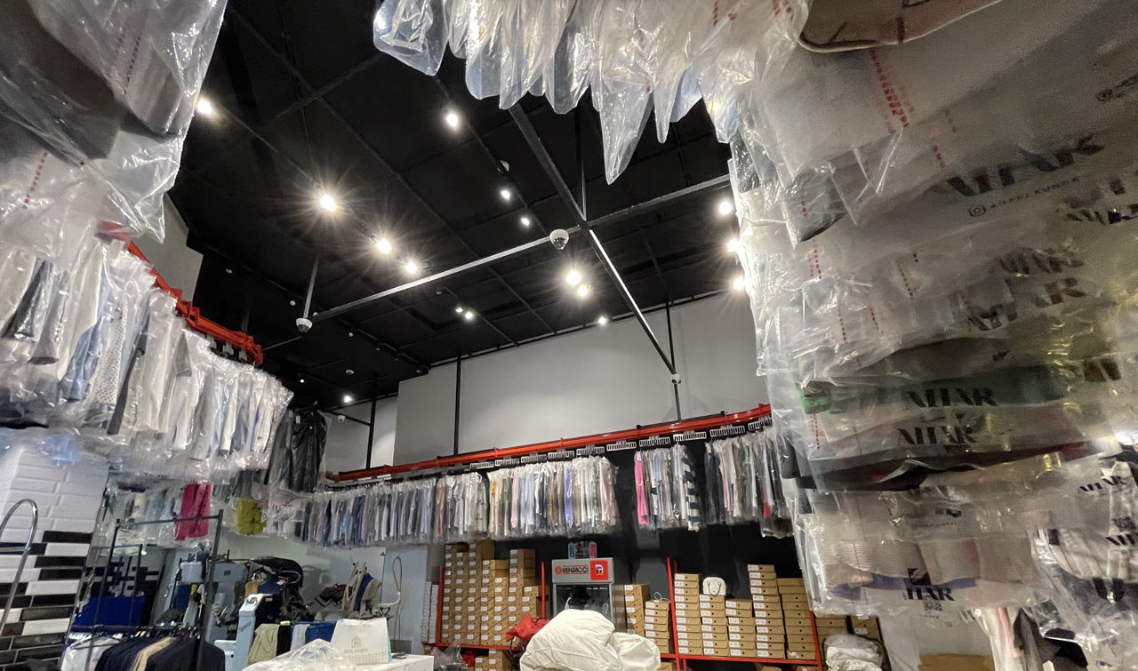
2
Comprehensive Ordering
Place an order with fewer clicks but more details.
1
Hybrid Connection
Simultaneous offline and online functionality. Ensuring that you stay connected and efficient, regardless of your internet status.
3
4
Item Reservation
Optimize your inventory and resource allocation by placing items with the same order number
Laundry Device Sync
Connect your dry-cleaning devices directly to our software via an open API
Optimize Your Inventory:
- Enhance resource allocation with defining storage and locations like conveyors, shelves, etc.
5
Image Capture
Mark stains or issues before cleaning. Customers can also view these photos on their phones
- Place items with the same order number next to each other for efficient organization.
- Differentiate and organize items by types, such as bedding, clothes, and long garments.
Improve Customer Satisfaction:
6
Innovative Real-Time Tracking
This system not only tracks items, but it also monitors employee working hours
- Reduce wait times, even during peak hours, by streamlining inventory management.
- Ensure a smoother and faster service experience for your customers.

Slide 8
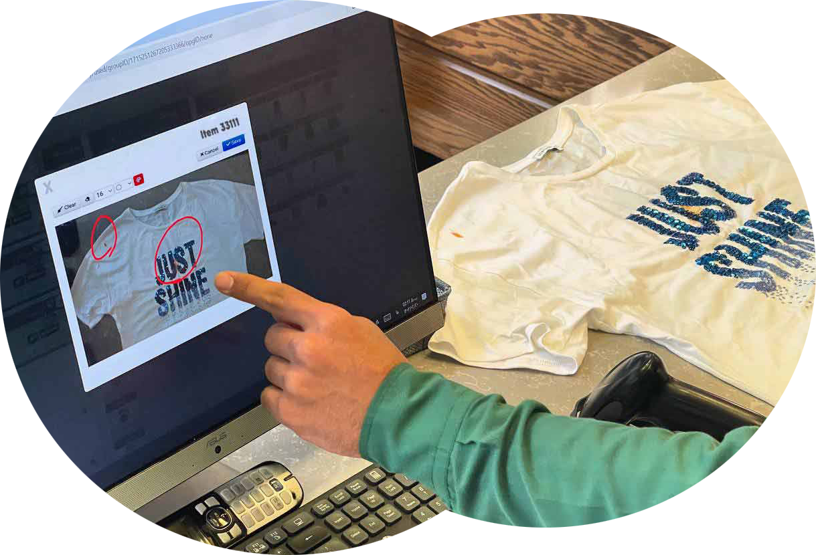
2
4
Item Reservation
Optimize your inventory and resource allocation by placing items with the same order number
Comprehensive Ordering
Place an order with fewer clicks but more details.
1
Hybrid Connection
Simultaneous offline and online functionality. Ensuring that you stay connected and efficient, regardless of your internet status.
3
Laundry Device Sync
Connect your dry-cleaning devices directly to our software via an open API
5
Image Capture
Mark stains or issues before cleaning. Customers can also view these photos on their phones
Document Garment Condition:
- Capture images of garments to document any stains or issues before cleaning.
Staff and Worker Access:
- Staff and workers can view images and information to ensure proper handling and care.
Customer Transparency:
- Customers can view these photos on their phones, keeping them informed about the condition of their items.
6
Innovative Real-Time Tracking
This system not only tracks items, but it also monitors employee working hours
- Provide peace of mind by showing customers the condition of their items before cleaning.

Slide 9
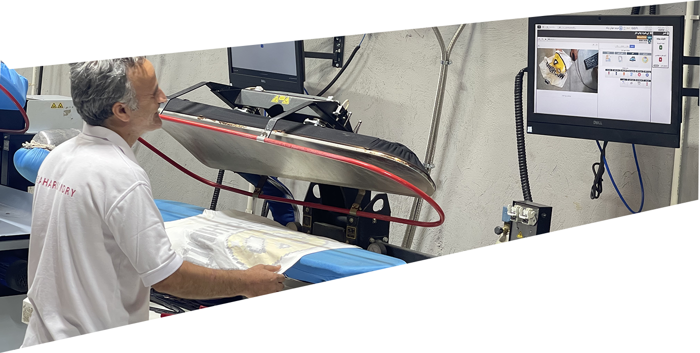

2
4
Item Reservation
Optimize your inventory and resource allocation by placing items with the same order number
Comprehensive Ordering
Place an order with fewer clicks but more details.
1
Hybrid Connection
Simultaneous offline and online functionality. Ensuring that you stay connected and efficient, regardless of your internet status.
5
Image Capture
Mark stains or issues before cleaning. Customers can also view these photos on their phones
3
6
Laundry Device Sync
Connect your dry-cleaning devices directly to our software via an open API
Innovative Real-Time Tracking
This system not only tracks items, but it also monitors employee working hours
Enhanced Accountability
- Monitor employee working hours, mistakes and returning items.
- Ensure accurate location tracking for each item in your operation, minimizing loss and improving accountability.
Comprehensive Reporting Tools:
- Gain valuable insights with detailed reports.
- Analyze performance metrics, customer trends, and operational efficiency to make informed decisions that drive growth and profitability.
Durable Barcodes:
Batch Processing:
- Washable barcodes that can withstand more than 40 washes.
- Embedded batch processing for faster barcode reading and data processing.

Slide 10
1
Hybrid Connection
Simultaneous offline and online functionality. Ensuring that you stay connected and efficient, regardless of your internet status.
4
Item Reservation
Optimize your inventory and resource allocation by placing items with the same order number
2
5
Image Capture
Mark stains or issues before cleaning. Customers can also view these photos on their phones
Comprehensive Ordering
Place an order with fewer clicks but more details.
6
3
Innovative Real-Time Tracking
This system not only tracks items, but it also monitors employee working hours
Laundry Device Sync
Connect your dry-cleaning devices directly to our software via an open API
Thank You
For Your Attention
CaramelSoftware.com

